Slide 1
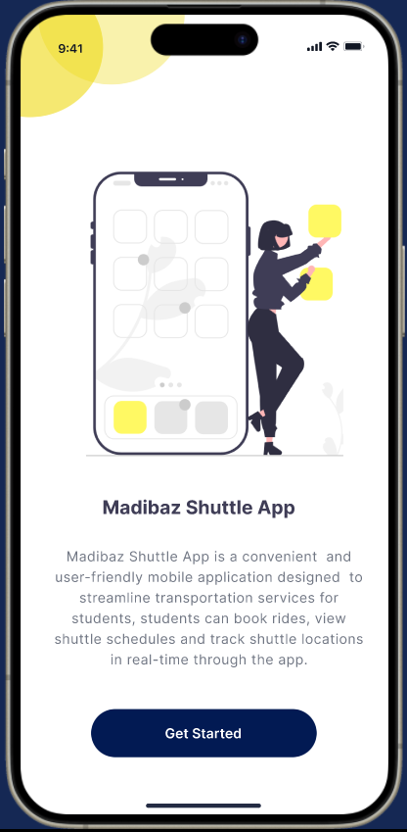
Madibaz Shuttle Services
Presentation By Group 4

Slide 2
INTRODUCTION
The Nelson Mandela University Shuttle Services App project
aims to design and develop a user-friendly mobile application to enhance
shuttle service accessibility for students. The app will enable students to view
shuttle schedules, book shuttles for their daily commute, and provide feedback
to improve the overall shuttle service experience.
Key Features and Benefits
The shuttle App offers efficient scheduling, user-friendly interface, notification system, book and reserve, safety and security, and more
The shuttle booking app offers convenience because students can easily book from their mobile devices, eliminating the need to wait long queues at physical pick-ups.

Slide 3
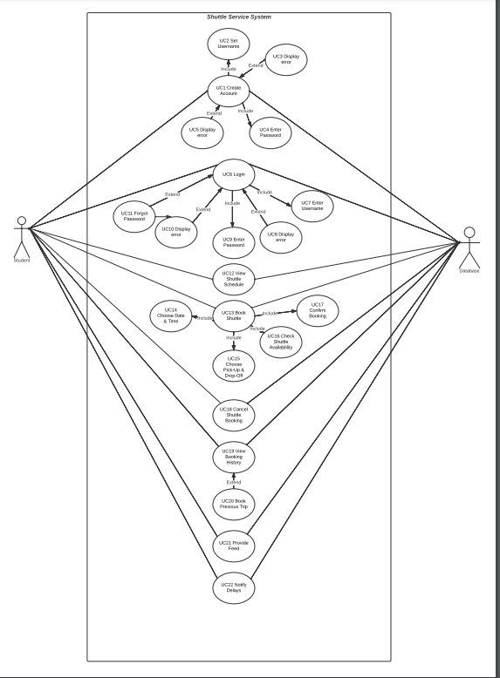
Use Case Diagram
This is a digital UCD showcasing the actors and actions taking place when the student(s) downloads the shuttle booking app.
Creating an account
Logging in
Viewing the shuttle schedule
Booking the shuttle and etc

Slide 4
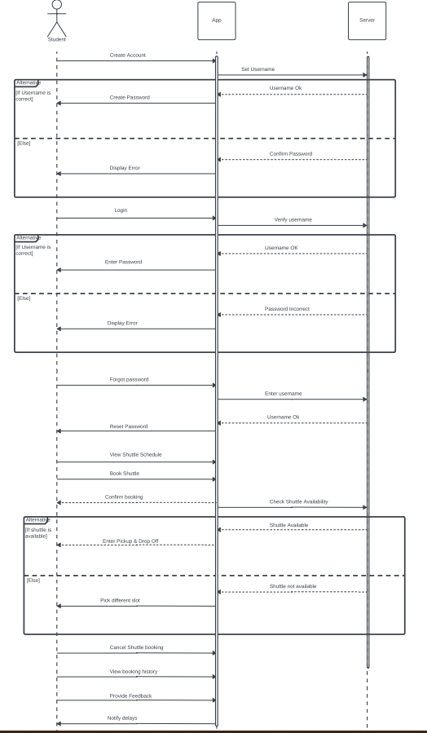
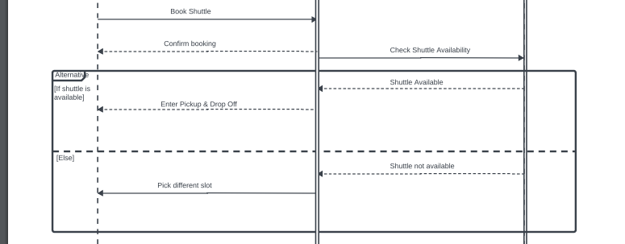
Sequence Diagram
Sequence Diagram is a system design to visually represent the interactions and order of events between various objects within a system.

Slide 5
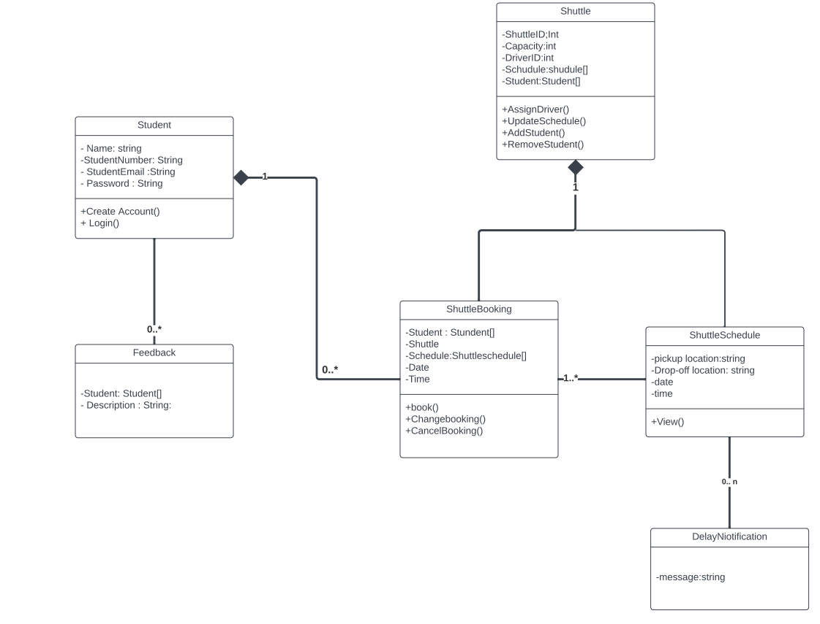
Class Diagram
A Class Diagram that represents the static structure of the app. Include classes, their attributes, and associations between classes.

Slide 6
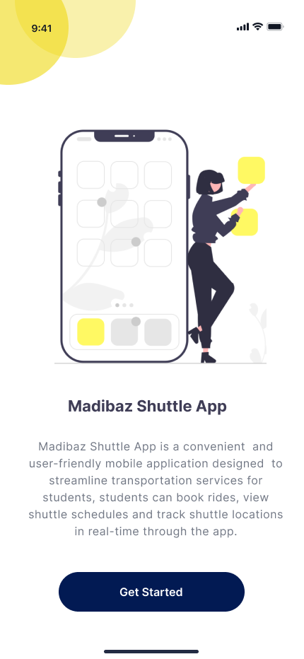
Click the Get started button

Slide 7
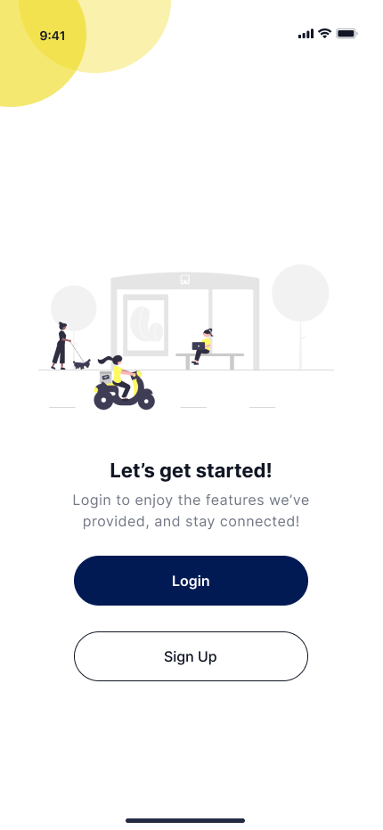
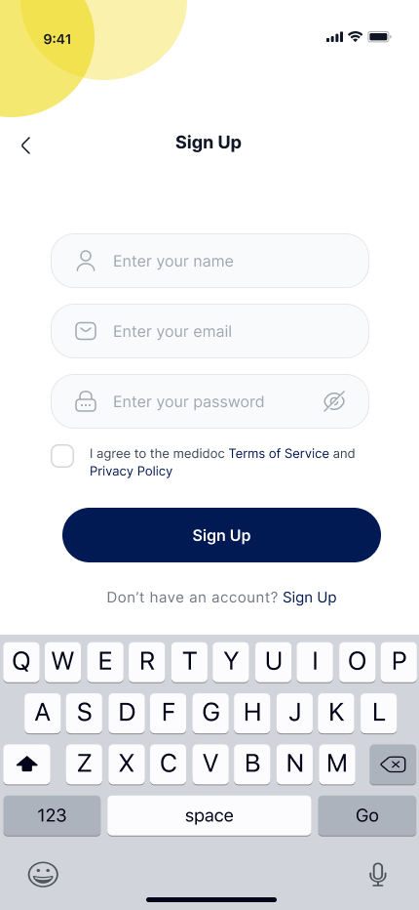
When you press the ‘Get started ‘ button, you need to create an account by using the sign-up button
N.B: But to create your account you need to first agree to the terms and conditions of the app

Slide 8
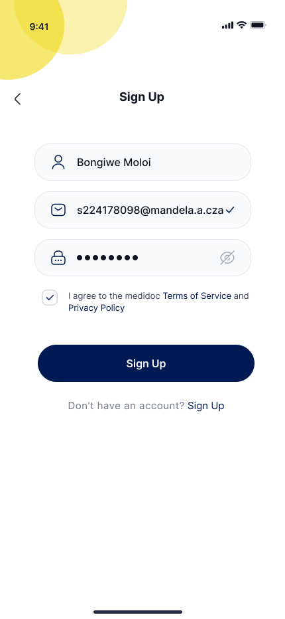
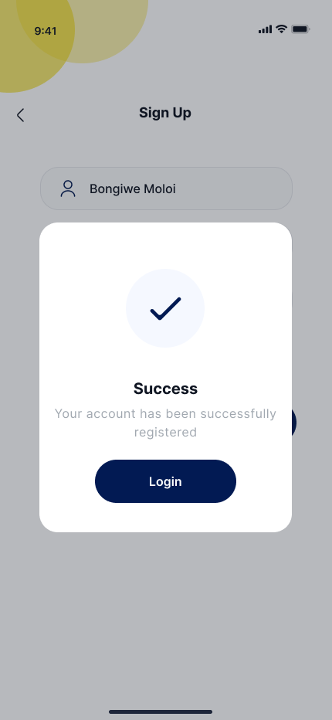
Fill in your details to create your account.
Use your NMU credentials to register successfully

Slide 9
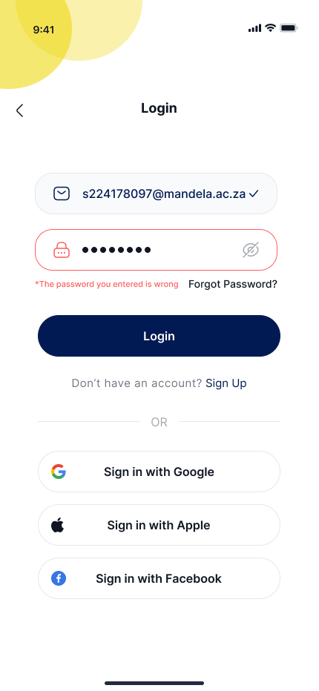
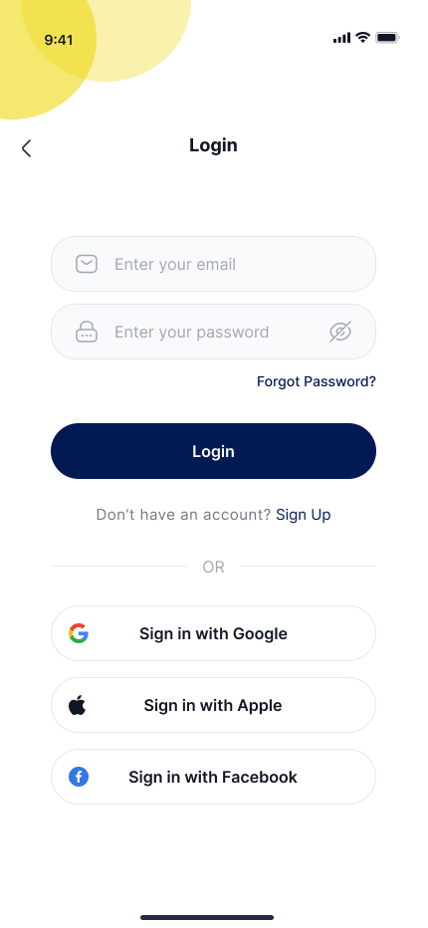
LOGGING IN
If you already have an account, login using the login button.
And if you have forgotten your login credentials use the Forgot Password to reset your password.

Slide 10
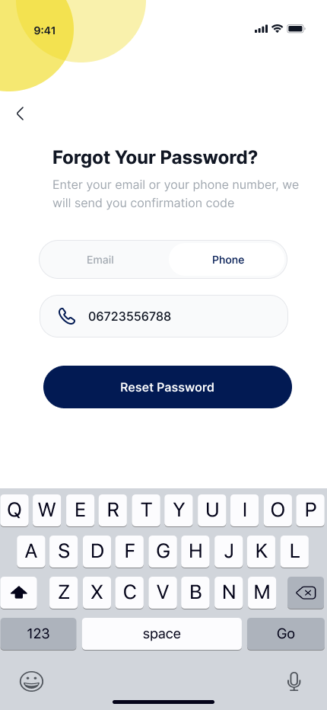
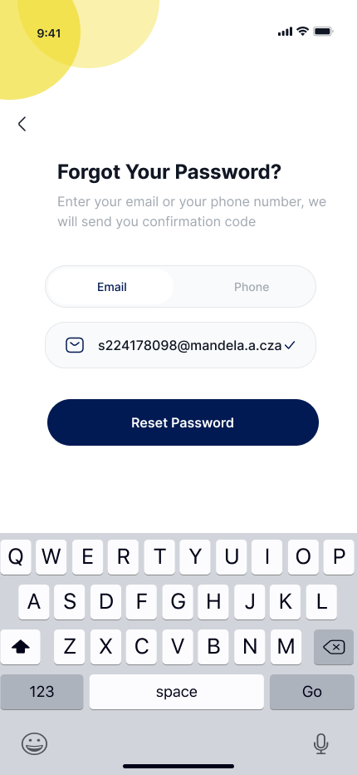
Forgot Password
OR
When you reset your password, you can choose use either phone number or your email address

Slide 11
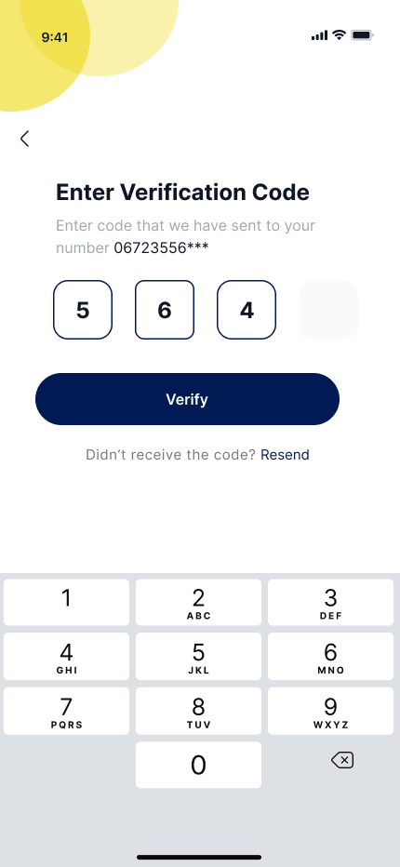
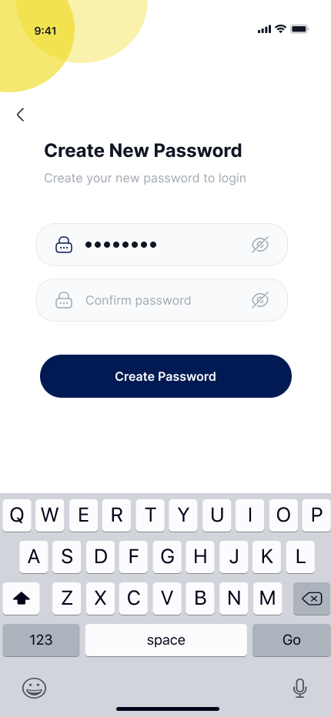
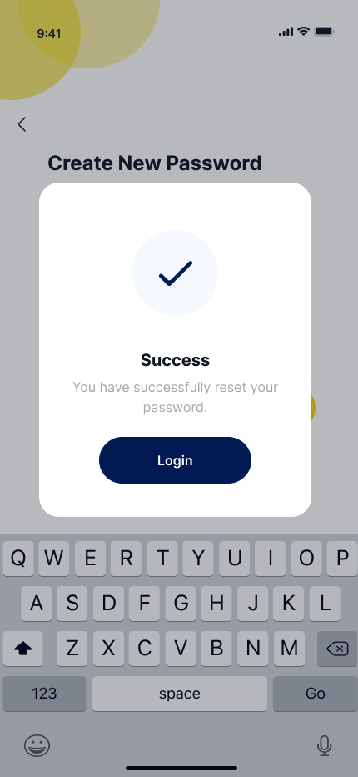
Creating a new password
After choosing to use either your phone number or email address, you will get a verification code and create a new password

Slide 12
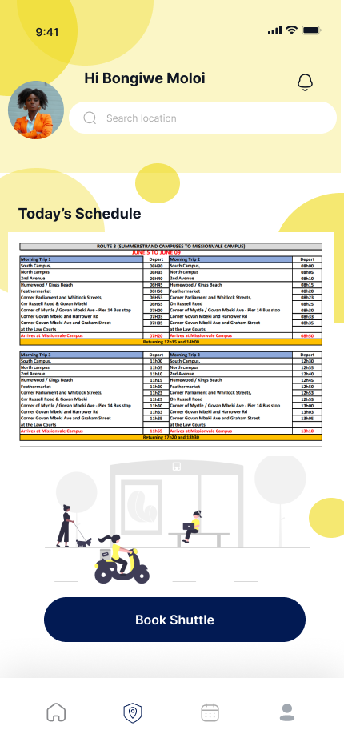
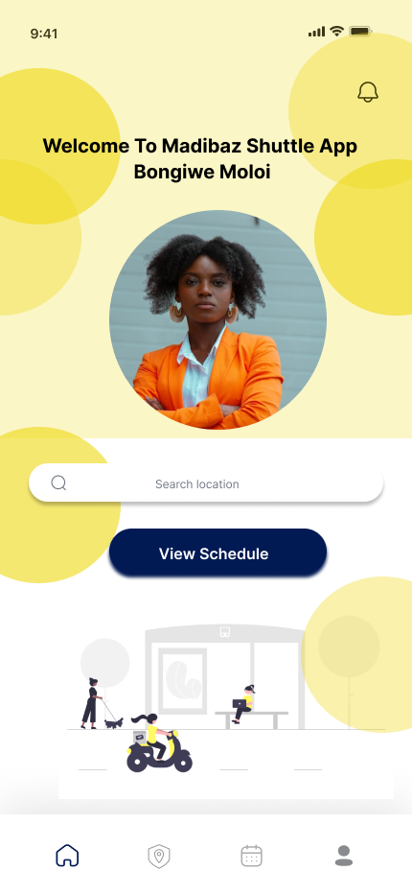
Viewing shuttle schedule
View today’s schedule to make your booking

Slide 13
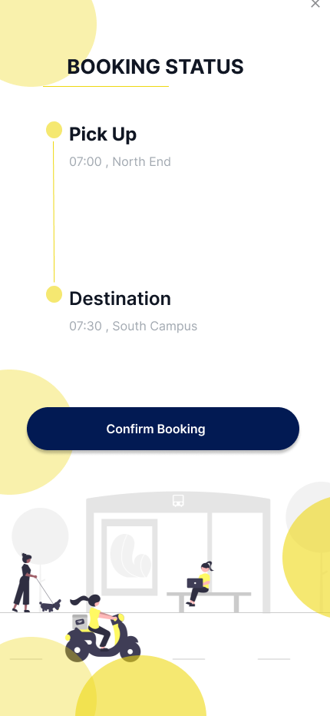
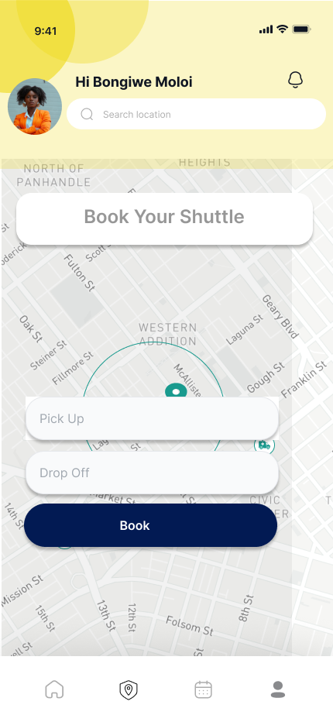
Make your booking
Choose your pick-up and your drop-off locations
After picking your locations you can press the booking button and then the booking status page will show up and then you can confirm your booking

Slide 14
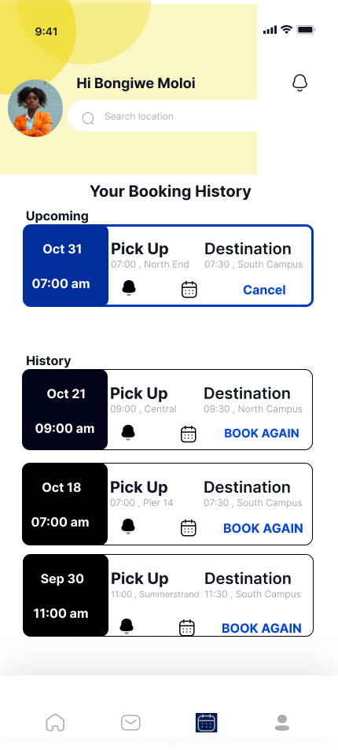
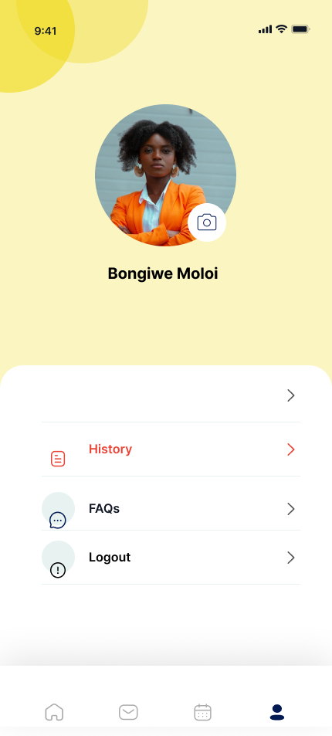
Booking history
Students can view their booking history by clicking the calendar icon at the bottom
Students are also able to cancel their booking by clicking the cancel button
They are also able to book a previous trip

Slide 15
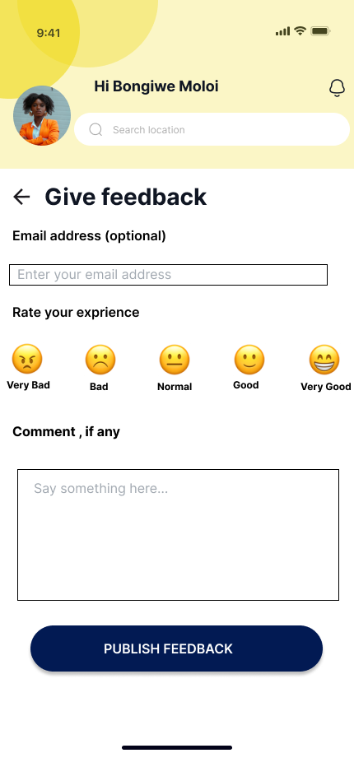
Provide feedback
Students are able to provide feedback of their experience with the shuttle or even the shuttle drivers
Students can choose to make their responses public/private by filling in their email address or not.

Slide 16
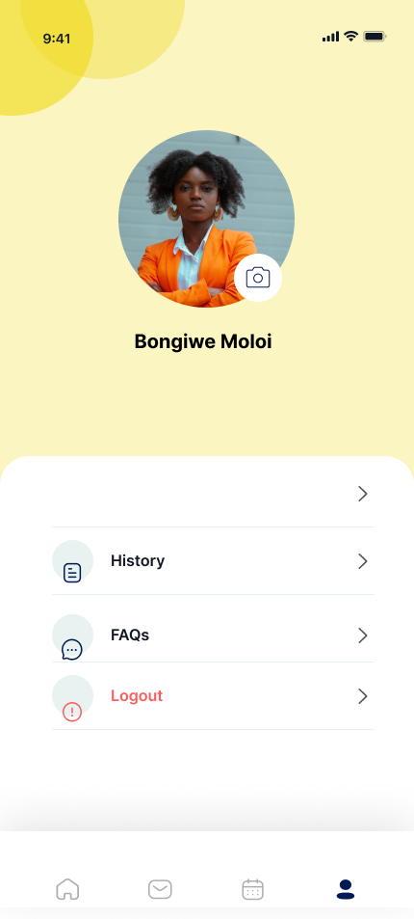
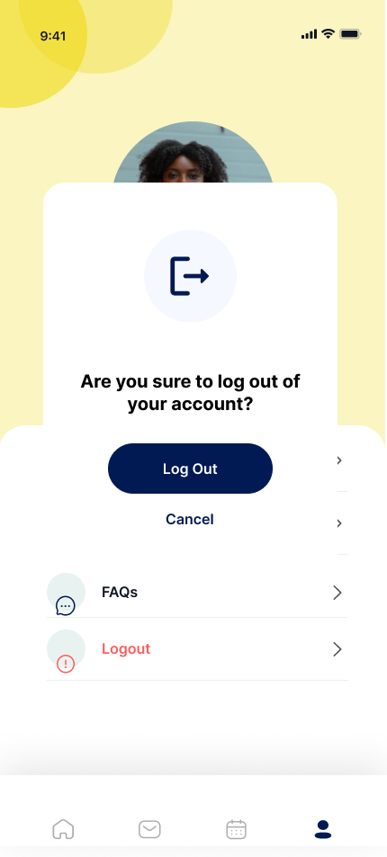
LOGGING OUT
After confirming your booking and/or providing feedback, students can logout of their account

Slide 17
CONCLUSION
In conclusion, the shuttle service app is a game changer addressing the transportation needs of students with efficiency, reliability and user-friendly design.
We aim to improve the way students move around providing a stress-free experience with efficient scheduling to enhance the overall experience
Download the shuttle service app today and discover the difference it can make in your student life
Your destination is just a tap away!!!!!!

Slide 18
THANK YOU!

